Slide 1
GENDER and SOCIAL INCLUSION
Land Finance Hub Training for Investors and MSMEs
Emily J. Gallagher
Scientist, Sustainable Value Chains and Investment
CIFOR-ICRAF, Nairobi, Kenya

Slide 2
The business case for gender inclusion
Gender inclusion in the supply chain
37 percent of the global workforce in agriculture are women
7 percent of total agriculture investment goes to women in forestry, fishing and agriculture
14 percent of management positions in the agricultural sector are held by women
5 percent of women in the agricultural sector in developing countries have access to agriculture extension services (FAO, 2013)
Less than 15 percent of agricultural landholders around the world are women (FAO, 2018)
Source: OECD Integrating a gender perspective into supply chain due diligence
Gender inclusion in the workplace
Increased profitability and organizational performance
Improved national productivity and economic growth
Resilient workplaces and national economies
Enhanced organizational reputation
Ability to attract talent and retain employees
Innovation
Source: USAID Engendering Industries: Developing Business Case for Gender Equality

Slide 3
What is ‘GENDER’ ???
MAN
Strong
WOMAN
Delicate
Which words do we use to describe an ideal man/woman?
What do we teach our children about being/becoming men/women?
Where do these ideas come from?

Slide 4
Example Word Cloud Responses
MAN BOX
WOMAN BOX

Slide 5
Gender and Social Inclusion: An introduction
Diversity and Inclusion: Diversity describes the variety of types of people in an organization, while inclusion refers to the environment and practices to make everyone feel welcomed and valued.
Gender
Generation
Religion
Ethnicity
Dis-Ability
Class
https://www.betterup.com

Slide 6
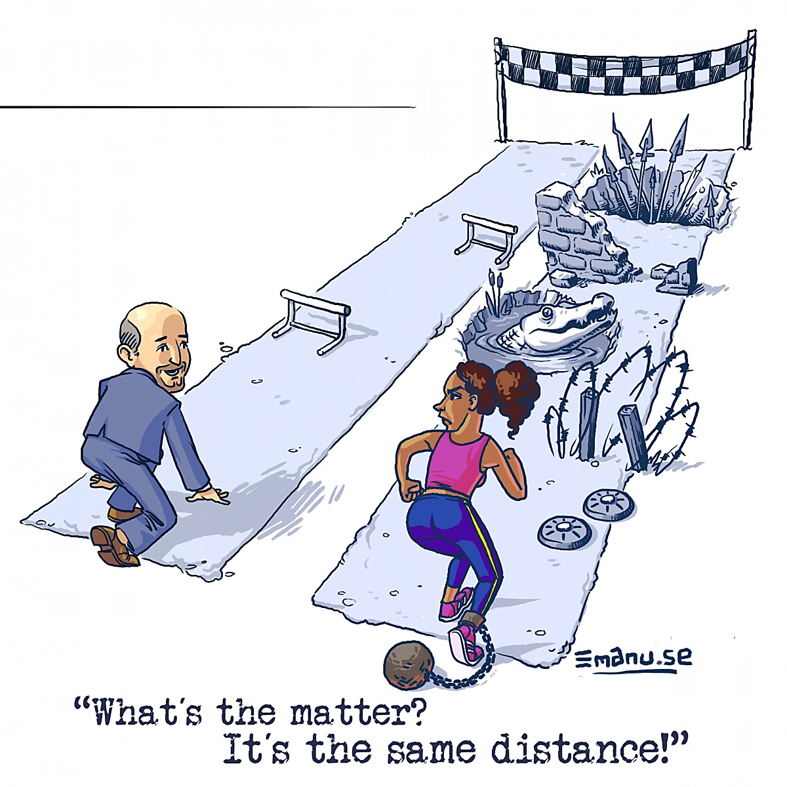
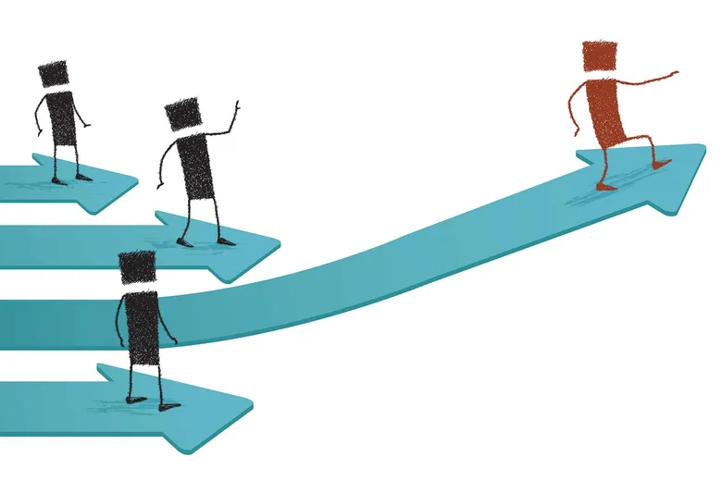
The Privilege Walk: Participatory activity for meetings and training sessions
Getty Images in Seattle Times
Tompkins County Structural Racism, Illustration by Emanu
Privilege Walk statements (examples)
Take two steps forward if you own land
Take one step backward if you lack land title
Take one step forward if you have a university degree
Take one step forward if you have regular wage employment
Take one step forward if anyone in your family has a political appointment
Take one step forward if …
Take one step backwards if …

Slide 7
Gender and social inclusion: How do we get there?
Men and women have equal access to, use of and benefit from material, financial, political and social resources.
Men and women have equal opportunities to actively participate and feel valued and accepted without fear of discrimination or violence.
Men and women are treated fairly according to their respective (but different!) needs.
Access
Inclusion
Equity

Slide 8
Gender inclusion in Value Chains and MSMEs
MSME
Administrative support
Hired laborers
Producers
Suppliers
Management/ Leadership
Core employees
Other VC actors
Professional women
Scientists
Skilled trades
Hired labor situations
Smallholder producers
Land and natural resource users

Slide 9
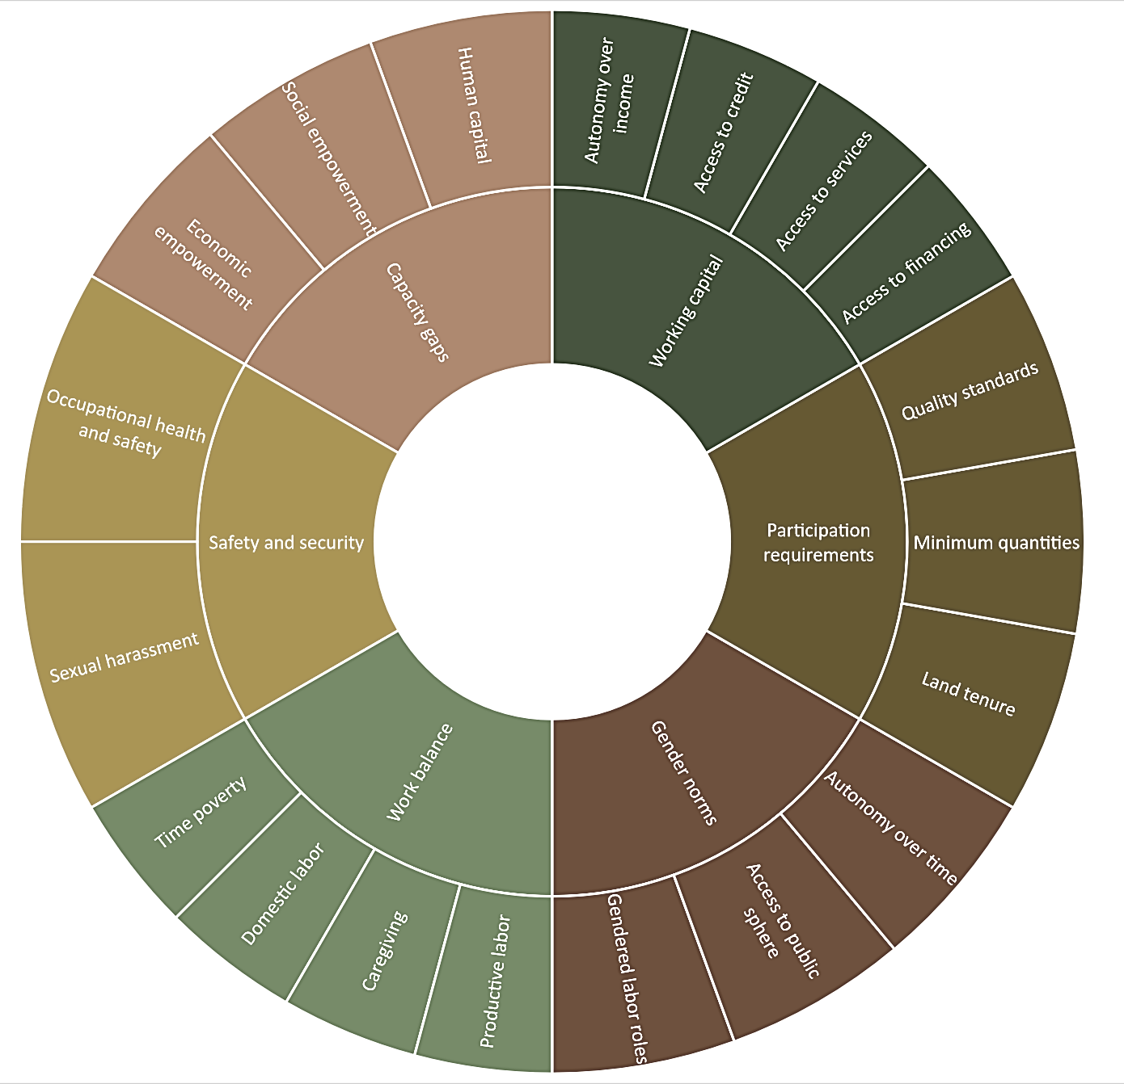
Gendered barriers in the value chain
Capacity gaps
Safety and security
Work balance
Gender norms
Participation requirements
Working capital

Slide 10
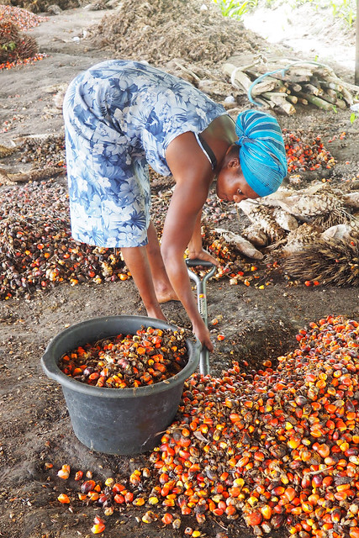
Gender roles in your value chain
What are the different roles and responsibilities for men and women in your value chain or business ecosystem?
Man
Woman
Gender roles in the value chain
Photo by Icaro Cooke Vieira/CIFOR
Photo by Ahtziri Gonzalez /CIFOR
Notes:
Can any of the ‘man’ words also describe women?
Can any of the ‘woman’ words also describe men?
What are the things that women or men can do exclusively?

Slide 11
Transforming gender roles
Man
Woman
Gender roles in the workplace and value network
Can these roles be reversed?
Photo by Marta Moreiras/BBC
Photo by Ollivier Girard/CIFOR

Slide 12
Gender and social inclusion in the workplace
* Recruitment practices * Opportunities for leadership roles * Promotion potential * Affirmative action
* Freedom from discrimination * Freedom from workplace harassment * Business culture * Training and capacity building opportunities
* Fair remuneration * Employee benefit packages * Flexible working arrangements * Bargaining power * Supply chain due diligence
Access
Inclusion
Equity

Slide 13
Gender and Social Inclusion in business practice
INWARD FACING
Number and types/gender of employees
Number of women in leadership positions
Gender-sensitive policies and benefits
Creating shared value
Number and types/gender of producers
OUTWARD FACING
Business profile
Online presence – Social messaging
Supply chain due diligence
Corporate social responsibility

Slide 14
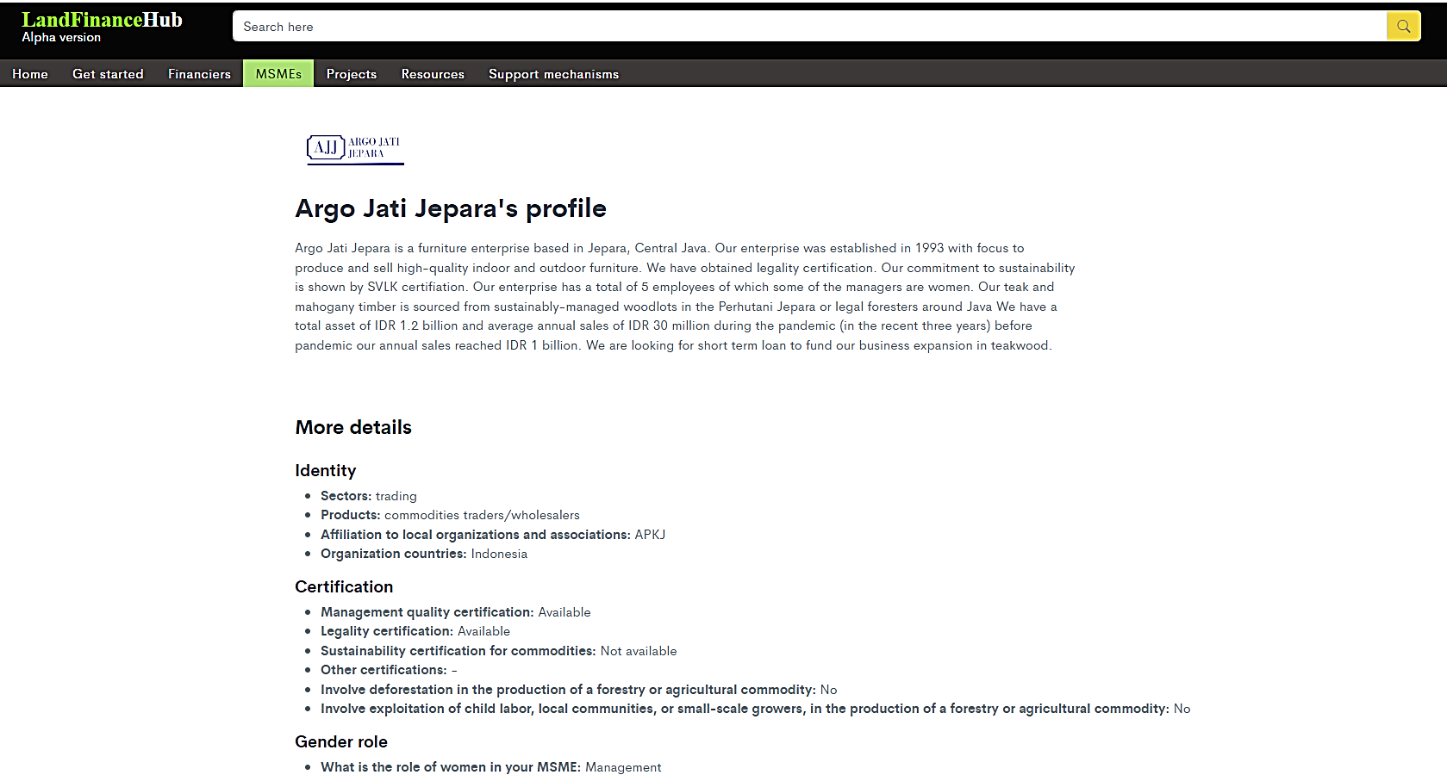
Gender and Social Inclusion Profiles on the Land Finance Hub

Slide 15
Thank you
e.gallagher@cifor-icraf.org

